Slide 1


Analysis of Clickbait in YouTube Videos using Ensemble Models
VISHAL KRISHNAN S H 170071601142
VISHAL R K 170071601143

Slide 2
Clickbait is something (such as a headline) designed to make readers want to click on a hyperlink especially when the link leads to content of dubious value or interest.
MERRIAM-WEBSTER
Clickbait is ever prevalent in the recent world of sensationalist media at the cost of journalistic integrity, and sure enough, it has plagued the most popular video services provider on the internet - YouTube.
Our project’s sole aim is to analyze and, eventually, create a model that helps detect clickbait, not only in currently uploaded videos, but also in any future video uploaded on the platform.

Slide 3
SCOPE OF THE PROJECT
The scope of this project extends to achieve the following 4 goals:
Analyze the amount clickbait present in a sample set of YouTube videos.
Detect factors that affect the viewer’s perception of what constitutes “clickbait”
Develop a Deep Learning Model that studies that aforementioned factors to categorize videos as “clickbait” and “not clickbait”
Test it on newly, non-encountered examples to measure its effectiveness and accuracy.
We are going to apply similar principles of news article clickbait detection, but for videos.

Slide 4

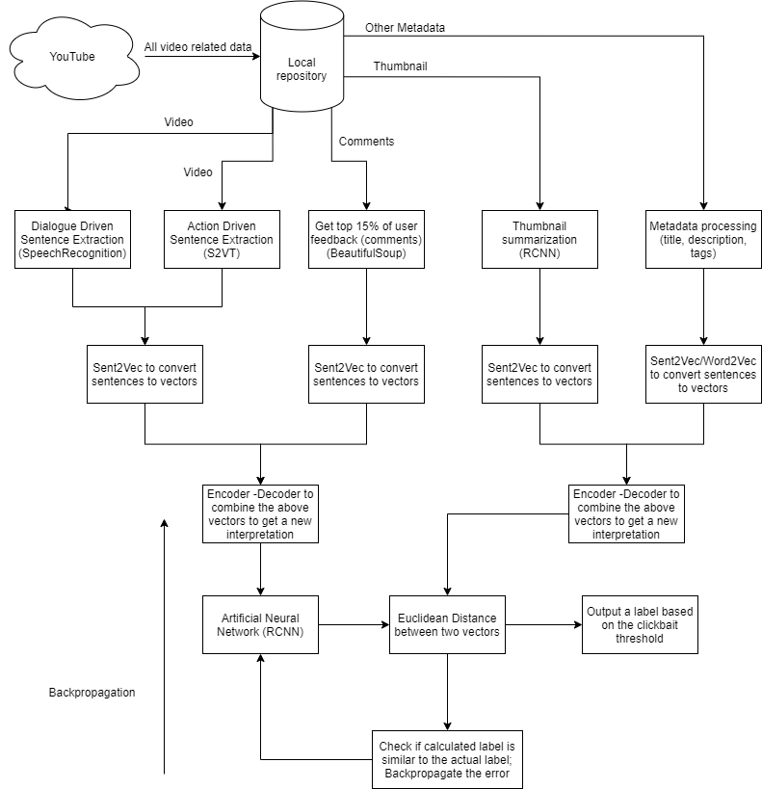
Proposed Architecture

Slide 5
INPUTS
Creator - fed values
Actual values
Headline
Thumbnail
Tags
Description
The video itself
User Comments
Other user interactions (liking other comments, liking the video itself, etc…)

Slide 6
INPUTS (contd.)
The corpus used for projects concerning YouTube is outdated, especially when it comes to clickbait and thus, we are going to extract video data on our own using a combination of
Google’s own YouTube API to gather metadata,
“tuber” – R package used for YouTube data mining purposes, and
BeautifulSoup – Python web scraping package to tie up any loose ends.
We will be gathering videos of all types categories and the percentages of videos used correlates with the total percentages of the specified categories currently present on YouTube.

Slide 7
PROCESSES
There are various ML and DL algorithms that will be used in our training model.
RCNN + LSTM + GRU – The most commonly used models for nearly all forms of clickbait detection.
S2VT – an RCNN model that is used to summarize videos to a textual format using raw frames
Long-Term CNNs – used to summarize thumbnails of videos
Sent2Vec and Word2Vec – used to create sentence and word embeddings (vectors)
Encoder-Decoder models – used to combine and create vectors of the two different input types

Slide 8
PROCESSES (contd.)
Other algorithms used include:
Adam – an adaptive learning rate optimization algorithm primarily used in most neural networks these days, especially for mini-batches as it is an extension of SGD and is the best of both worlds between RMSprop and AdaGrad
Backpropagation – it is the staple of any neural network. It computes the gradient of the loss function with respect to the weights of the network for a single input–output example, and does so efficiently. It is always used in conjunction with an optimization algorithm, in our case, Adam.

Slide 9
OUTPUT & METRICS
The output is a value between 0 and 1, which based on a threshold value (hyperparameter that can be tuned later based on overall performance), yields a binary label – “clickbait” and “not clickbait”
The performance metrics include:
Accuracy (a simple confusion matrix of TP-TN and FP-FN) – Precision, Recall and F-Score
Efficiency (a ratio of the time taken to process a single video to the length of the video itself)
Percentage accuracy (used for overall correct and incorrect predictions by the model)

Slide 10
MODULES
The entire process can be summarized into the following modules:
Data Extraction – from YouTube to local repository
Data Pre-processing – converting all data to embeddings/vectors
Model Training – feeding the word embeddings into an ANN and generate a binary label, and backprop the error/loss to retrain the model.
Model Testing – test the model with unseen videos to gauge its accuracy and efficiency.
Model Deployment (future work)

Slide 11
SOFTWARE
The primary tools, software, and websites used are as follows:
Google Colaboratory – an online python notebook environment
RStudio – an R programming language IDE
Google API – an API platform provided by Google
YouTube – the video hosting site on which the project is based on
SocialBlade – to mine video analytics and performance

Slide 12
SOFTWARE (contd.)
The packages used are as follows:
Tensorflow + Keras – DL framework
Seaborn – for data visualization
SpeechRecognition – to extract text from audio
NLTK – an all-purpose NLP library in python
BeautifulSoup – for web scraping
Tuber – to gather YouTube metadata via R
and other trivial packages like numpy, pandas, scikit-learn etc…

Slide 13
SOFTWARE (contd.)
The beauty of Colab is that it is cloud-based – we can work on it from any machine and we don’t need extensive hardware resources ourselves, and best of all, it’s free up to a limit.
They have provisions to use either GPUs (making efficient use of CUDA cores) or TPUs (tensor processing units).
Thus, it is not technically required to install an IDE to work on deep learning.
Nevertheless, we have installed the other software and an alternative to Colab (Jupyter Notebooks).

Slide 14
FRONT-END DESIGN
As of now, our project doesn’t require any front-end design as it is purely analytical.
But, in the future, there is a plan to release it as an extension which people can download and, based on the video that they are watching, the extension can output the “clickbait” tendency of the video in question.
Of course, that purely depends on how this model performs in a purely experimental environment in the first place, and then, there are scalability and deployment issues to tackle as well.

Slide 15
REFERENCES
Sarjak Chawda, Aditi Patil, Abhishek Singh, Prof. Ashwini Save ,' A Novel Approach for Clickbait Detection’ - Proceedings of the Third International Conference on Trends in Electronics and Informatics (ICOEI 2019) IEEE Xplore Part Number: CFP19J32-ART; ISBN: 978-1-5386-9439-8
E. Uzun, "A Novel Web Scraping Approach Using the Additional Information Obtained From Web Pages," in IEEE Access, vol. 8, pp. 61726-61740, 2020, doi: 10.1109/ACCESS.2020.2984503.
Meng Wang, Richang Hong, Guangda Li, Zheng-Jun Zha, Shuicheng Yan, Tat-Seng Chua ‘Event Driven Web Video Summarization by Tag Localization and Key-Shot Identification’ in IEEE TRANSACTIONS ON MULTIMEDIA, VOL. 14, NO. 4, AUGUST 2012
Andrej Karpathy,Li Fei-Fei ‘Deep Visual-Semantic Alignments for Generating Image Descriptions’ – Proceedings of the IEEE Conference on Computer Vision and Pattern Recognition (CVPR), 2015, pp. 3128-3137

Slide 16
REFERENCES
Jeff Donahue, Lisa Anne Hendricks, Marcus Rohrbach, Subhashini Venugopalan, Sergio Guadarrama,Kate Saenko, Trevor Darrell ‘Long-term Recurrent Convolutional Networks for Visual Recognition and Description’
Oriol Vinyals, Alexander Toshev, Samy Bengio, Dumitru Erhan ‘Show and Tell: A Neural Image Caption Generator’ - Proceedings of the IEEE Conference on Computer Vision and Pattern Recognition (CVPR), 2015, pp. 3156-3164
Kelvin Xu, Jimmy Lei Ba, Ryan Kiros, Kyunghyun Cho, Aaron Courville, Ruslan Salakhutdinov, Richard S. Zemel, Yoshua Bengio ‘Show, Attend and Tell: Neural Image Caption Generation with Visual Attention’ - Proceedings of the 32nd International Conference on Machine Learning, PMLR 37:2048-2057, 2015.

Slide 17
REFERENCES
Subhashini Venugopalan,Marcus Rohrbach,Jeff Donahue,Raymond Mooney ,Trevor Darrell,Kate Saenko “Sequence to Sequence – Video to Text” - Proceedings of the IEEE International Conference on Computer Vision (ICCV), 2015, pp. 4534-4542
Abinash Pujahari and Dilip Singh Sisodia “Clickbait Detection using Multiple Categorization Techniques”
Shu, Kai & Wang, Suhang & Lee, Dongwon & Liu, Huan. “(2020). Mining Disinformation and Fake News: Concepts, Methods, and Recent Advancements” 10.1007/978-3-030-42699-6_1.

Slide 18
THANK YOU

